Slide 1
Frito Lay - Case Study 2
Edgar Nunez

Slide 2
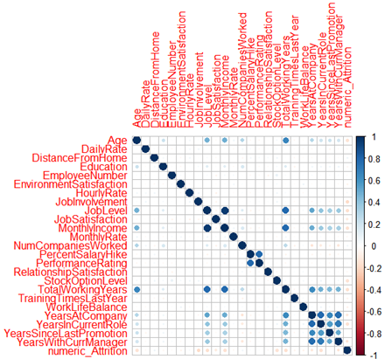
Correlation analysis
The correlation analysis reveled the following findings:
the strongest correlation is between JobLevel and Monthly income, with correlation at 0.95
the more total working years, the more Job Level, with correlation at 0.780
the more total working years, the more Monthly Income, with correlation at 0.778
the more performance rating, the more Percent salary hike, with correlation at 0.775
the more yearsatcompany, the more yearsInCurrentRole, with correlation at 0.776
the more yearswithcurrmanager, the more yearsatcompany, with correlation at 0.765
the more yearswithcurrmanager, the more yearsincurrentrole, with correlation at 0.709

Slide 3
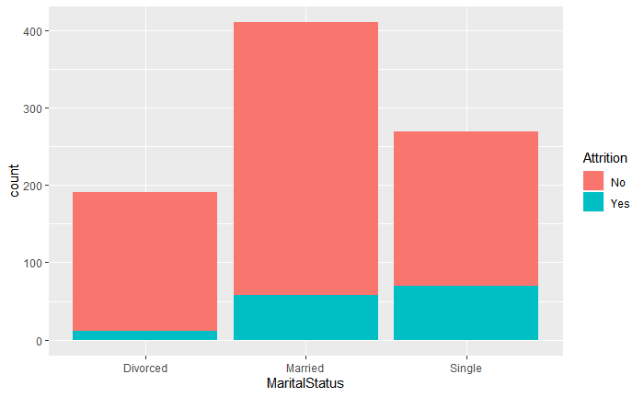
Marital Status vs Attrition
The Marital Status vs Attrition plot show that personnel who are single have a higher attrition rate and divorced personnel has the lowest attrition. However, married personnel has the lowest attrition rate.

Slide 4
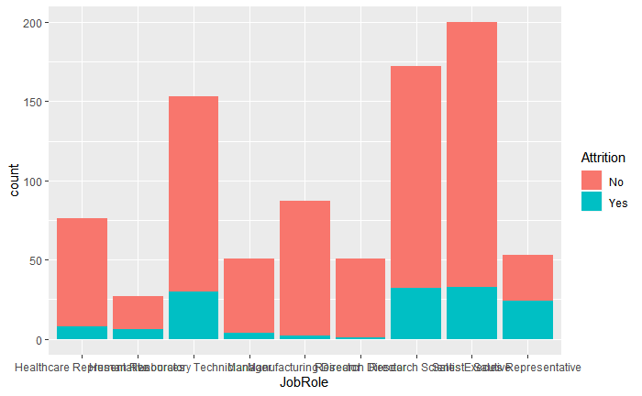
Job Role vs Attrition
The JobRole vs Attrition plot shows that laboratory technician, human resources and sales representative roles have more attrition.

Slide 5
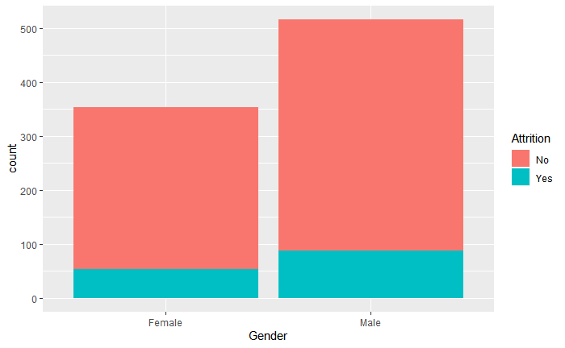
Gender vs Attrition
The Gender vs Attrition plot shows that the gender characteristic is not significant

Slide 6
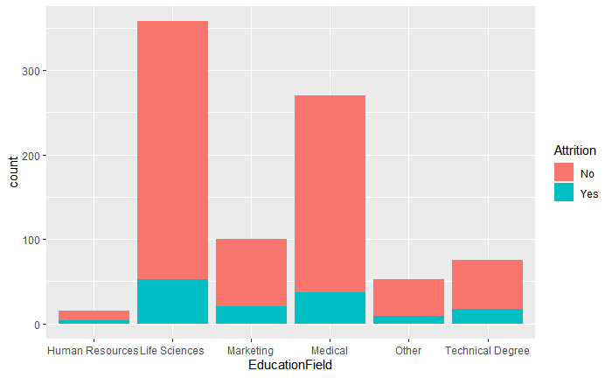
Education Field vs Attrition
The Education Field vs Attrition plot shows that technical degree and human resources have the highest attrition ratios.

Slide 7
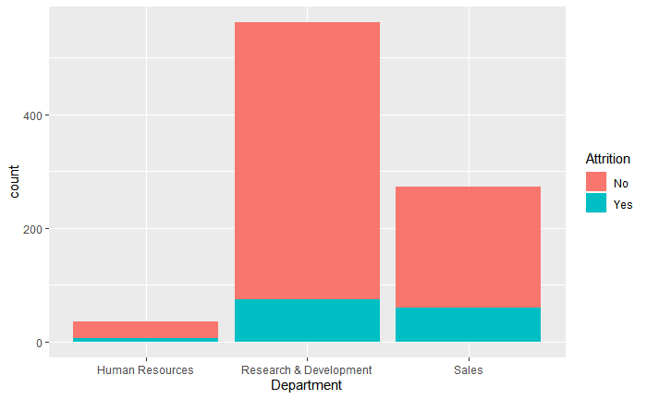
Department vs Attrition
The Department vs Attrition plot show that the department attrition ratios are not significant

Slide 8
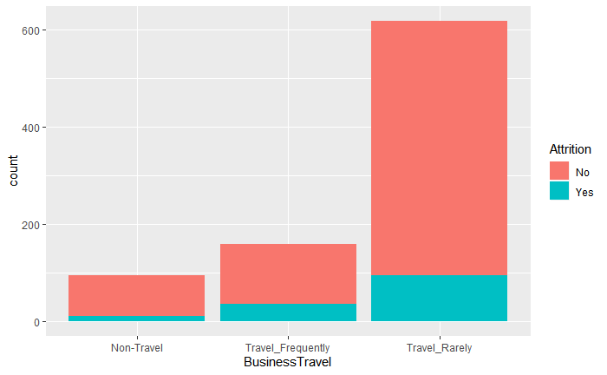
Business Travel vs Attrition
The BusinessTravel vs Attrition plot shows that the ratio of attrition increases with increases in travel frequency increases.

Slide 9
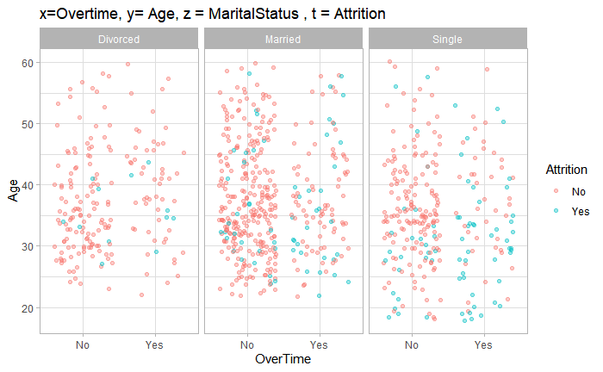
Cumulative attrition ratio
Apparently, attrition ratio is cumulative when the following conditions are present:
Personnel does over time, are single, and are less than 35 years old.

Slide 10
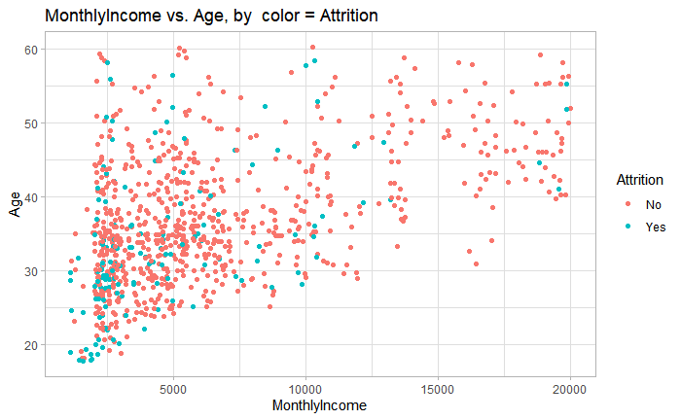
Monthly Income vs. Age
There is a tendency for monthly income to increase as age increases.
Attrition frequency tends to decrease as monthly income increases

Slide 11
Predicting attrition with accuracy
We use a logistic regression model with prediction accuracy of about 83% to predict employee's attrition, based on relevant predictor variables.

Slide 12
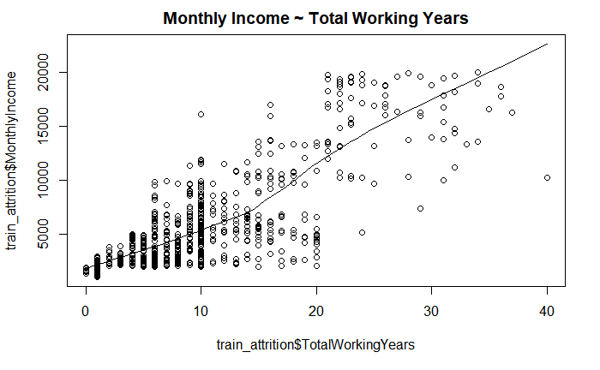
Linear regression model
Total working years is a strong predictor of monthly income
A strong positive correlation of 0.778

Slide 13
Regression model conclusion
For every one year increase in Total Working Years the Monthly Income increases by 475.7, starting at a base monthly income of 1117.8 with a 95% confidence level, small p-value: < 2.2e-16
Statistically significant model

